Slide 1

Workplace Productivity & Time Management
Time is our most valuable resource. Effective management transforms how we work, enabling us to achieve more with less stress and greater satisfaction.
This presentation will explore strategies to boost productivity, eliminate time wasters, and create a more balanced professional life.

Slide 2

The Cost of Time Mismanagement
40%
Productivity Lost
Average worker wastes significant time daily
$15K
Annual Cost
Estimated per employee in lost productivity
7.5H
Weekly Waste
Hours potentially lost to ineffective work methods

Slide 3

Developing a Productivity Mindset
Growth Orientation
Embrace continuous learning and skill development.
Intentional Focus
Practice deliberate concentration and minimize distractions.
Positive Habits
Build consistent routines that support peak performance.

Slide 4




Time-Saving Technology & Tools
Time Tracking
Apps that monitor and analyze work patterns
Scheduling
Advanced calendar and meeting management tools
Task Management
Digital platforms for organizing and prioritizing work

Slide 5




Eliminating Time Traps
Identify Distractions
Recognize and map your specific productivity barriers.
Minimize Interruptions
Create strategies to reduce unnecessary communication.
Set Boundaries
Establish clear limits on meetings and digital notifications.

Slide 6



Task Prioritization Strategies
Urgent Tasks
1
Immediate, time-sensitive work
Important Projects
2
Strategic, high-impact initiatives
Long-Term Goals
3
Sustainable professional development

Slide 7
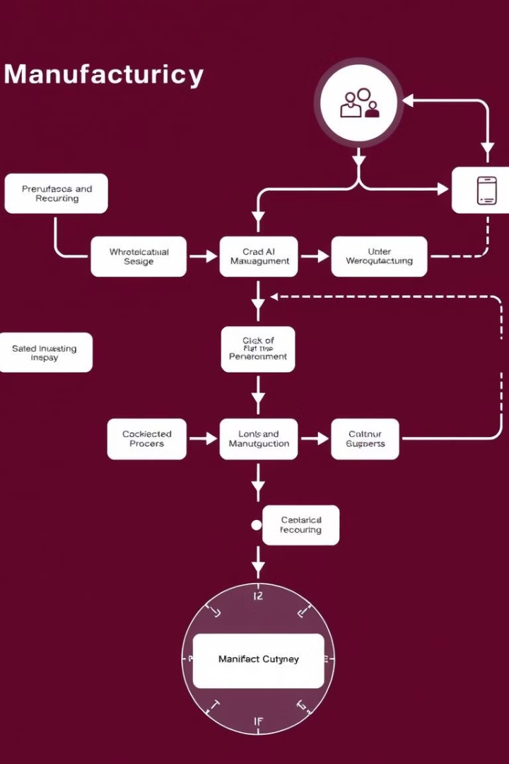
Workflow Optimization Techniques
1
Analysis
Evaluate current work processes
2
Streamline
Remove unnecessary steps and bottlenecks
3
Automate
Implement technological solutions

Slide 8
Maintaining Work-Life Balance
Personal Boundaries
Self-Care
Flexible Approach
Set clear limits between professional and personal time.
Prioritize mental and physical well-being.
Adapt strategies to individual needs and contexts.

